Slide 1
Digital Explorer Badges Specials
David Stevens

Slide 2
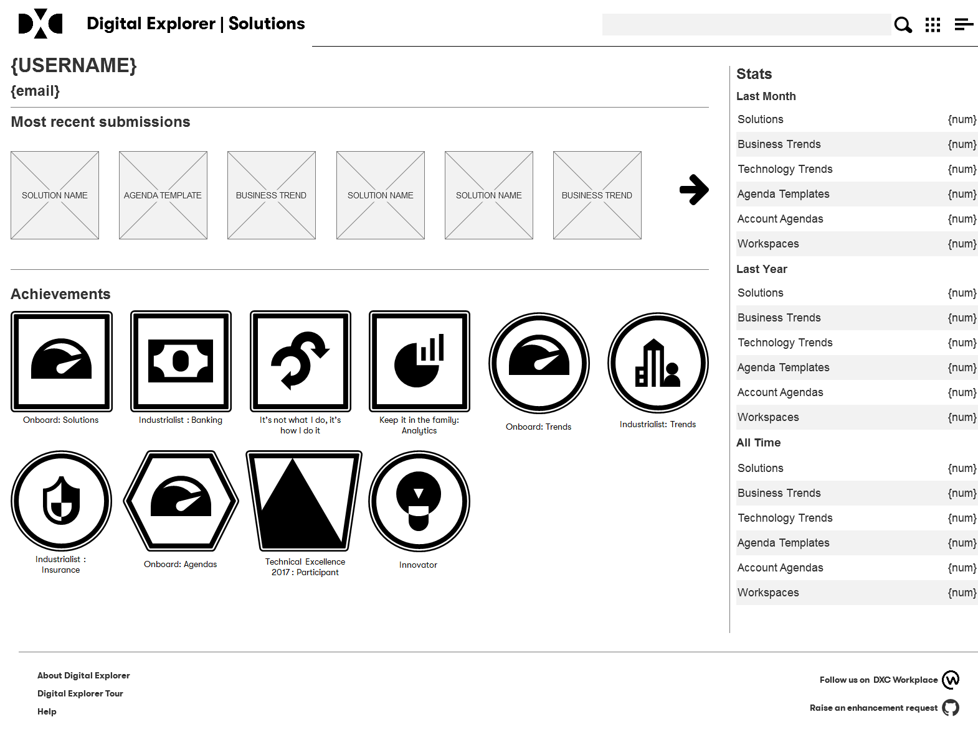
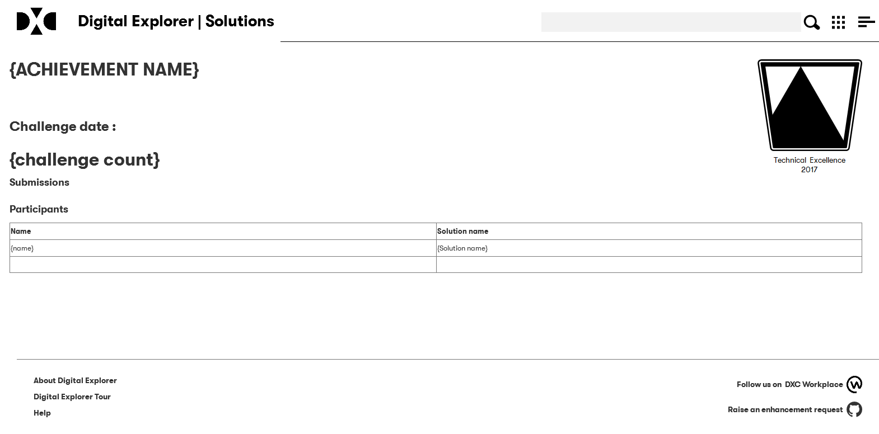
Revised user profile pages and achievement/challenge leader boards

Slide 3
Badge design constraints
Solutions
Trends
Must align to DXC colours
Must leverage or compliment DXC standard icons
Standard image size of 250px x 250px
Workspace
Agendas
Challenges

Slide 4

Digital Explorer Badge : Challenges
Calculated based on the tagged valued against solutions
Name
Participant | Submit a solution for an event
Winner | Member of the winning team
Unique icon for each event – need a designer
Technical Excellence 2017 : Participant
Technical Excellence 2017 : Winner
Technical Excellence 2017

